Slide 1
Building Your First Application

Slide 2
Objectives
Setting up your environment
Using Expo Go
Using React Native CLI
Creating a new application
Project initialization
Passing and change state data between components
Run the application on a device emulator

Slide 3
Setting up your environment

Slide 4

Expo Go
If you are new to mobile development, the easiest way to get started is with Expo Go.
Expo is a set of tools and services built around React Native.
You will only need a recent version of Node.js and a phone or emulator.
If you'd like to try out React Native directly in your web browser before installing any tools, you can try out Snack

Slide 5
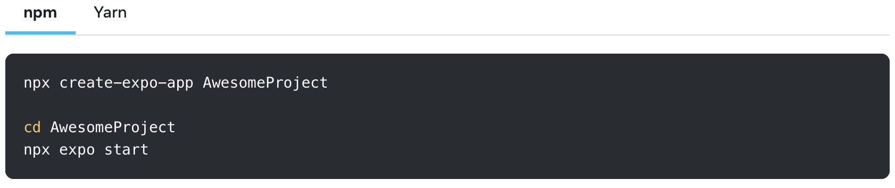
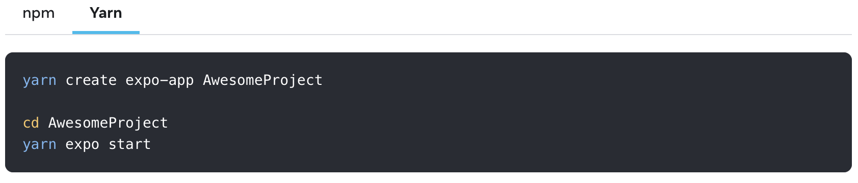
Expo Go (contd.)
Run the following command to create a new React Native project called "AwesomeProject":
Or:

Slide 6
Expo Go (contd.)
Running your React Native application
Install the Expo Go app on your iOS or Android phone and connect to the same wireless network as your computer.
On Android, use the Expo Go app to scan the QR code from your terminal to open your project.
On iOS, use the built-in QR code scanner of the default iOS Camera app.
Modifying your app
Open App.js in your text editor of choice and edit some lines.
The application should reload automatically once you save your changes.

Slide 7
React Native CLI
If you are already familiar with mobile development, you may want to use React Native CLI.
For example, if you are integrating React Native into an existing application, or if you ran "prebuild" from Expo to generate your project's native code, you'll need this section.
Development OS
Windows + Android
MacOS + iOS and MacOS + Android

Slide 8
Windows + Android
Installing dependencies
We will need Node, the React Native command line interface, a JDK, and Android Studio.
Node (v18.16.0)
Download link: https://nodejs.org/en/download
OpenJDK (v11.0.19 LTS)
Download link: https://learn.microsoft.com/en-us/java/openjdk/download

Slide 9
Windows + Android (contd.)
Install Android Studio
Download link: https://developer.android.com/studio/index.html
While on Android Studio installation wizard, make sure the boxes next to all of the following items are checked:
Android SDK
Android SDK Platform
Android Virtual Device
If you are not already using Hyper-V: Performance (Intel ® HAXM)

Slide 10
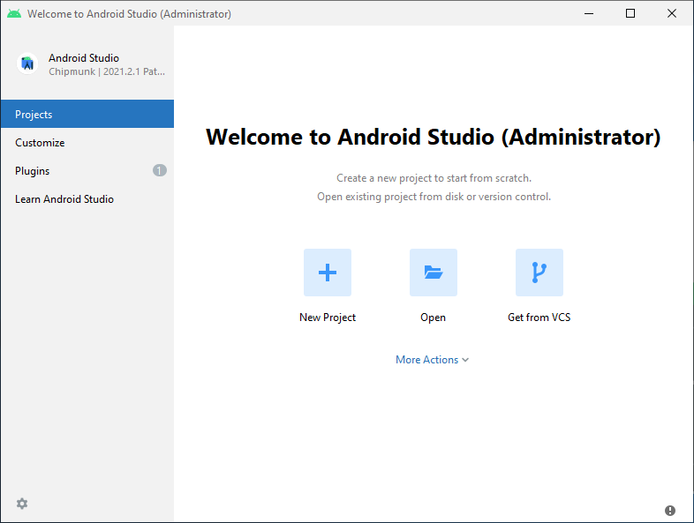
Windows + Android (contd.)
Install the Android SDK
To do that, open Android Studio, click on "More Actions" button and select "SDK Manager".

Slide 11
Windows + Android (contd.)
Install the Android SDK (contd.)
Select the “SDK Platforms” tab from within the SDK Manager, then check the box next to “Show Package Details” in the bottom right corner. Look for and expand the Android 13 (Tiramisu) entry, then make sure the following items are checked:
Android SDK Platform 33
Intel x86 Atom_64 System Image or Google APIs Intel x86 Atom System Image
Next, select the “SDK Tools” tab and check the box next to “Show Package Details” here as well. Look for and expand the Android SDK Build-Tools entry, then make sure that 33.0.0 is selected.
Finally, click “Apply” to download and install the Android SDK and related build tools.

Slide 12
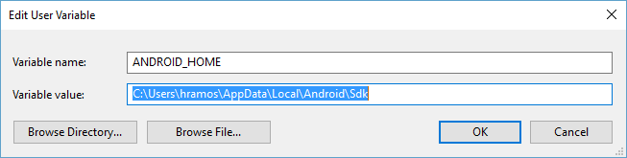
Windows + Android (contd.)
Configure the ANDROID_HOME environment variable
The React Native tools require some environment variables to be set up in order to build apps with native code.
Open the Windows Control Panel.
Click on User Accounts, then click User Accounts again.
Click on Change my environment variables.
Click on New... to create a new ANDROID_HOME user variable that points to the path to your Android SDK:

Slide 13
Windows + Android (contd.)
Configure the ANDROID_HOME environment variable
The SDK is installed, by default, at the following location:
You can find the actual location of the SDK in the Android Studio "Settings" dialog, under Appearance & Behavior → System Settings → Android SDK.
Open a new Command Prompt window to ensure the new environment variable is loaded before proceeding to the next step.
Open powershell
Copy and paste Get-ChildItem -Path Env:\ into powershell
Verify ANDROID_HOME has been added

Slide 14
Windows + Android (contd.)
Add platform-tools to Path
Open the Windows Control Panel.
Click on User Accounts, then click User Accounts again.
Click on Change my environment variables.
Select the Path variable.
Click Edit.
Click New and add the path to platform-tools to the list.
The default location for this folder is:

Slide 15
Windows + Android (contd.)
Creating a new application
If you previously installed a global react-native-cli package, please remove it as it may cause unexpected issues:
Let's create a new React Native project called “AwesomeProject”:

Slide 16
Windows + Android (contd.)
Preparing the Android device
Using a virtual device
If you use Android Studio to open ./AwesomeProject/android, you can see the list of available Android Virtual Devices (AVDs) by opening the "AVD Manager" from within Android Studio
If you have recently installed Android Studio, you will likely need to create a new AVD. Select "Create Virtual Device...", then pick any Phone from the list and click "Next", then select the Tiramisu API Level 33 image.
Click "Next" then "Finish" to create your AVD. At this point you should be able to click on the green triangle button next to your AVD to launch it, then proceed to the next step.

Slide 17

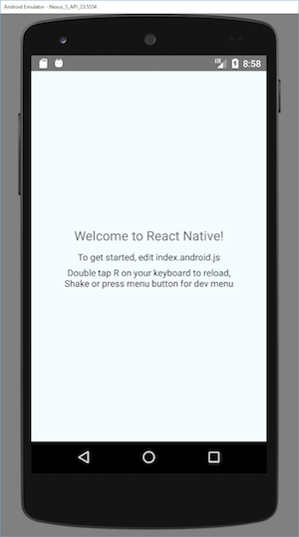

Windows + Android (contd.)
Running your React Native application
Step 1: Start Metro
Step 2: Start your application
If everything is set up correctly, you should see your new app running in your Android emulator shortly.

Slide 18
Creating a new application
(using Expo Go)

Slide 19
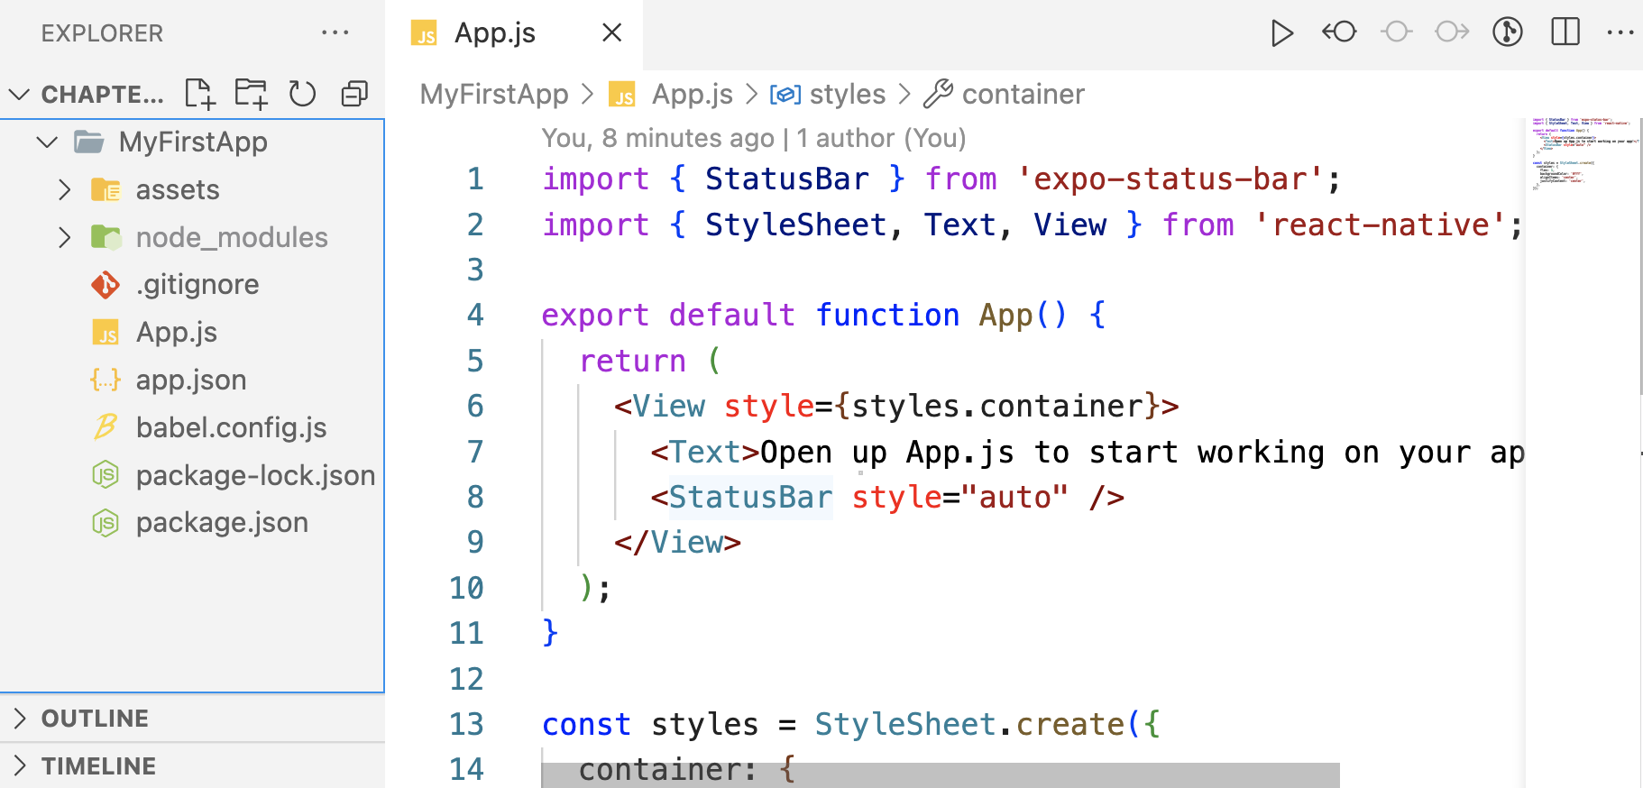
Project Initialization
Using Terminal in VS Code execute the command to create a project named "MyFirstApp":
> npx create-expo-app MyFirstApp

Slide 20
Passing and change state data between components
Props is a JavaScript object that React components receive as a non-compliant installation to produce a React element.
They provide data flow between components. Transferring data (props) from one component to another as a parameter.
In the class section you need to define a component to which you assign your data and transfer it via the special React JSX syntax.

Slide 21
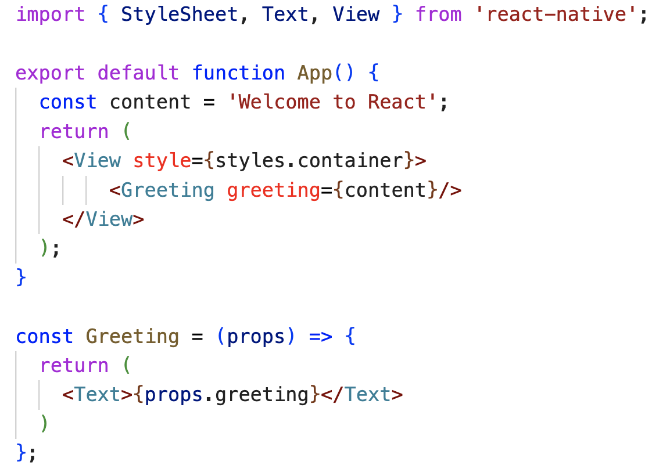
Props definition
In this example, data was a string variable. But props can be anything such as integers, objects, arrays, and even React components.

Slide 22


Props definition (contd.)
Run the app on iOS and Android emulators:

Slide 23
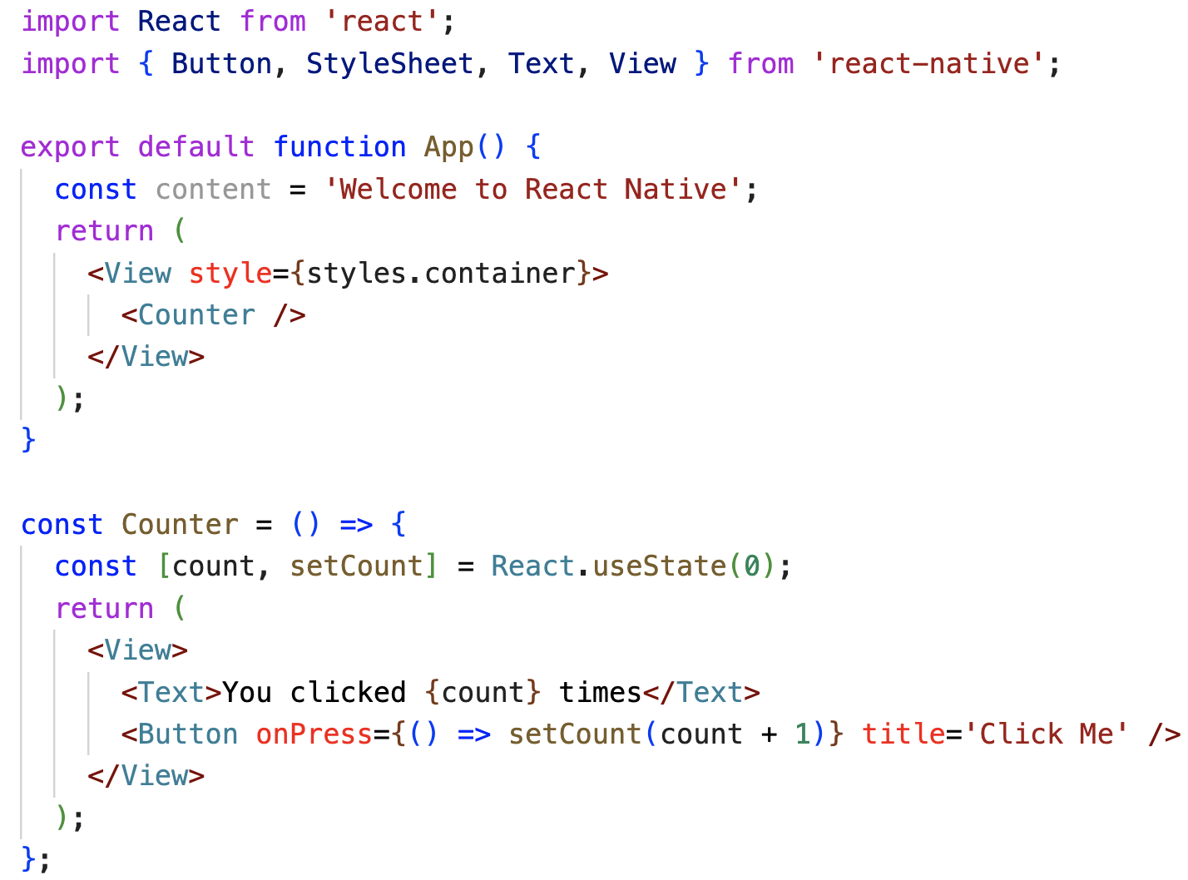
State definition
State is a JavaScript object that contains data that influences how a component looks in a particular area at a time.

Slide 24




State definition (contd.)
Run the app on iOS and Android emulators:

Slide 25




State definition (contd.)
Run the app on Android emulators:

Slide 26
Summary
In this session, we learned the following:
Step-by-Step to setting up your environment
Using Expo Go
Using React Native CLI
Understand to creating a new application
Project initialization
Passing and change state data between components
Run the application on a device emulator

